Slide 1
Advanced Cloud Computing
SUBMITTED BY
ADRI SAHA
ID: M240105050
DEPARTMENT OF COMPUTER SCIENCE AND ENGINEERING (CSE)

Slide 2

Title: Explaining the Workings Principle of Cloud-based Multi-factor Authentication Architecture on Banking Sectors
Journal Details
Authors: Rajesh Bose, Srabanti Chakraborty, Sandip Roy
Publisher: Amity International Conference on Artificial Intelligence (AICAI)
Link: https://ieeexplore.ieee.org/document/8701317

Slide 3

Cloud Doctors

Slide 4


Overview
Introduction & Motive
Multi-factor Authentication
Cloud based solutions
Cloud-based Architecture
Components of Multi-factor Authentication
Working Principle of Cloud-based MFA
Security Mechanisms
User experience enhancement
Proposed Work
Implementation Challenges
Case Studies
Conclusion
Q&A

Slide 5



Introduction
Cloud computing transforms banking data management and security.
Aim
Proposed multi-factor authentication system.
MFA with VPN, biometrics, and dynamic passwords.
Protects sensitive banking data.

Slide 6

What is MFA?
Multi-factor Authentication
Extra security layer.
Passwords, biometrics, tokens for user identity verification.
Shifts to Cloud-based Solutions for scalability, accessibility, cost-effectiveness.

Slide 7
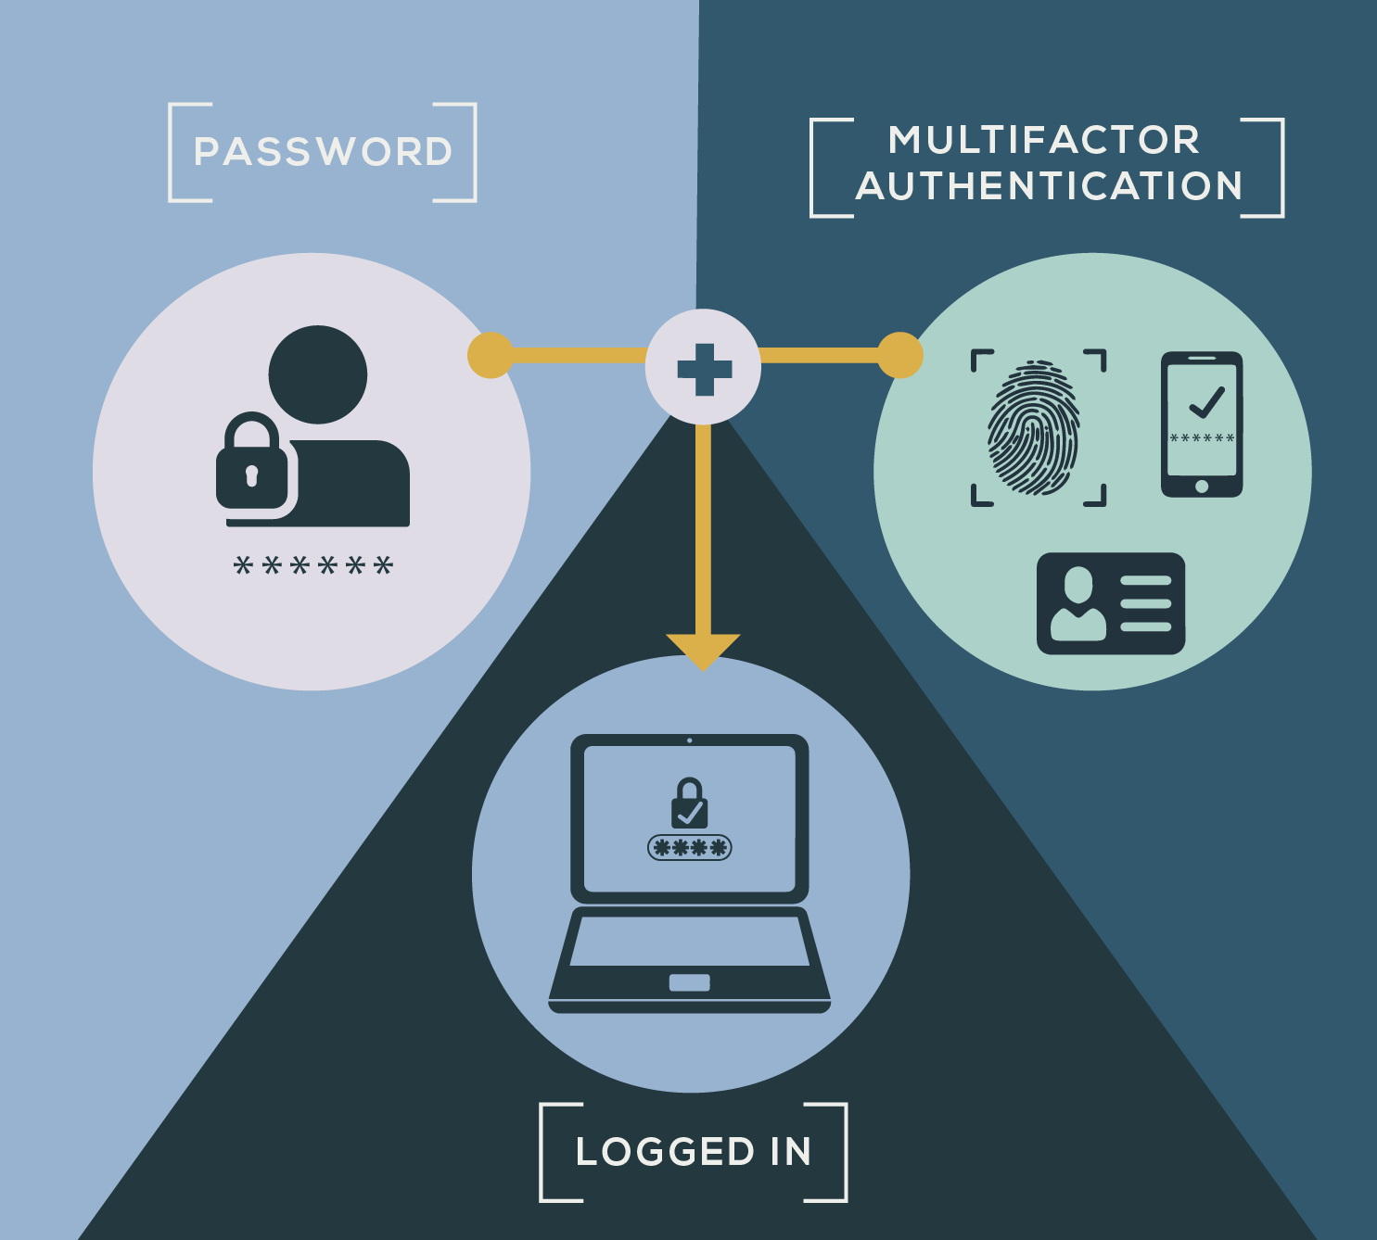
Components of Multi-factor Authentication
Authentication Factors:
Knowledge Factor: Password, PIN, Security Question, Captcha
Possession Factor: Token/OTP/Smart Card
Inherence Factor: Fingerprints, Facial Recognition, Psychological Characters
Multi Factor Authentication

Slide 8
Importance of Cloud based solutions
Usage-
based billing
Enhanced Business Continuity
Business Flexibility
Green IT

Slide 9
Cloud-based Architecture
Centralized Authentication Server
Integration with Banking Systems
Basic Architecture Overview
Interconnected server network with virtual machines.
Access services via web browsers or apps.
Hosts banking apps on cloud services.
Enables seamless communication
Stores credentials safely.
Encryption for security.

Slide 10
Working Principle of Cloud-based MFA
Cloud Based Authentication
Banking System
User
User Initiates Authentication Request
Transmission of Data to Cloud Server
Authentication Decision Process
Secure Communication Channels

Slide 11
Security Mechanisms
Encryption Techniques
Tokenization Processes
Secure Protocols (e.g. OAuth, OpenID Connect)
Converts data into coded form to prevent unauthorized access.
Unique passwords or OTP for single-use authentication.
HTTPS encrypts web server-browser data.
SSL/TLS secure internet connections.

Slide 12

User Experience Enhancement
Seamless Authentication Flows
Reduced Friction for users
Adaptability to Various Devices

Slide 13
Proposed work
Billboard Manager (BM) as gateway which Provides SSL services, user database.
Users access banking via HTTPS link and authenticate with username and password for entry.
BM configures secure browser access.

Slide 14
Proposed work
BFA (Biometric Fingerprint Authentication)authentication via USB.
Enhanced security: transaction passwords or OTPs.
Experimentation with Citrix AG Virtual appliances.

Slide 15
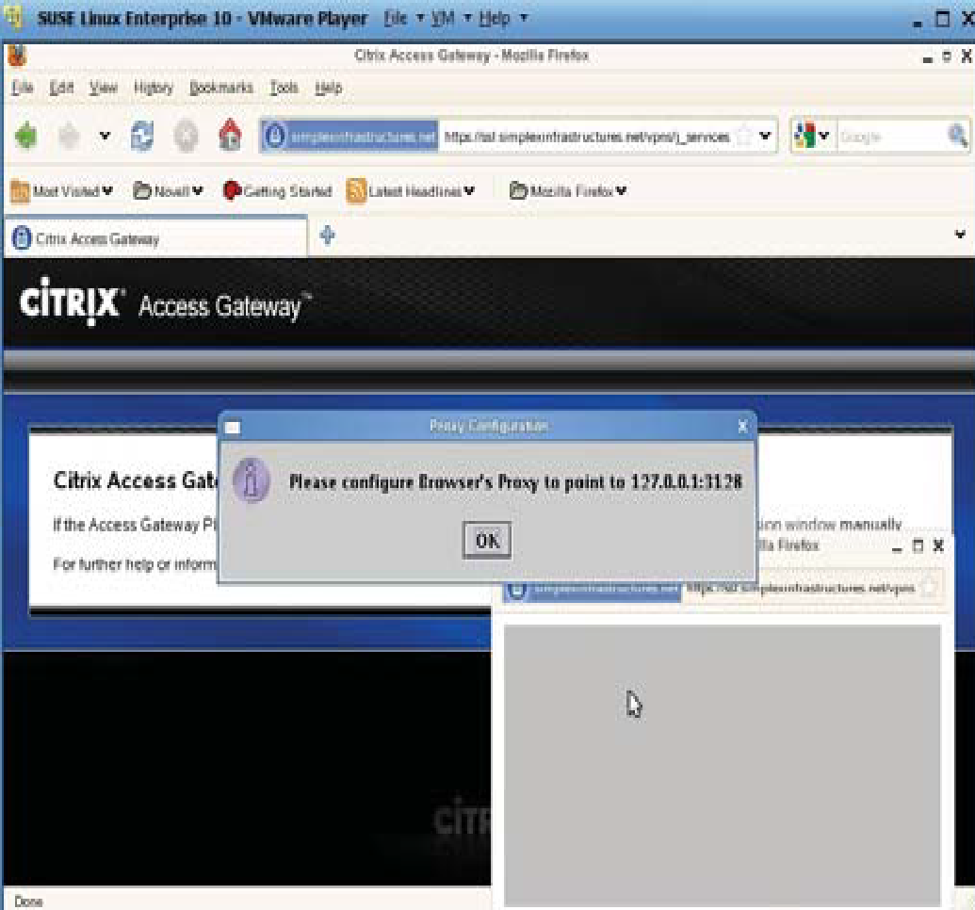
Implementation Challenges and Solutions
Regulatory Compliance (e.g. GDPR, PCI DSS)
Data Privacy Concerns
Integration with Legacy Systems

Slide 16

Case Studies
Example of
Banks Implementing Cloud-based MFA
Success Stories and Lessons Learned

Slide 17

Conclusion
Multi-factor authentication strengthens cloud banking security.
Triple-stage verification ensures secure identity validation and potential threats.
Emphasis on Security and User Experience.
Future Outlook for Cloud-based MFA.
AI and Machine Learning in Authentication

Slide 18

Finding Research Question
1. How does implementation of MFA enhance the security of a Cloud based banking system?
2. What are the key challenges for online banking systems security?
3. What types of green IT initiatives are commonly utilized in cloud-based banking systems to reduce environmental impact?
4. How do cyber risks such as phishing and DDoS attacks affect cloud banking security and how can banks mitigate them?

Slide 19


Slide 20
Any Question?

Slide 21
Answer of some research questions
How does implementation of MFA enhance the security of a Cloud based banking system?
Ans: Two-factor authentication means that each app or service you login to double-checks that the request came from you by confirming the login with you in a separate location.
You've probably used MFA before, even if you didn't know it. For example, if a website has ever sent a numeric code to your phone that you must enter to gain access, you have completed a multi-factor transaction.
MFA is essential to web security because it immediately neutralizes the risks associated with compromised passwords. If the password is hacked, guessed, or even fraudulent, this is no longer enough to grant access to the intruder: without the backing of the two factors, the password alone is useless.
MFA also does something necessary to maintain a strong security posture: it actively engages users in the security process and forms a condition in which users are informed. stakeholders about their digital security. When the 2FA notification comes to users, they must answer: "Did I do this or is someone trying to access my account?" » This emphasizes the matter of security in all transactions.

Slide 22
2. What are the key challenges for online banking systems security?
Ans: Cyber Threats: There are a lot of challenges banks have to face during the changing environment of cyber threats like malware attack including spy-eye, phishing, DDoS, cross-site and man-in-the-browser attacks. To mitigate these risks constant attention to detail and preventive measures are needed.
Credential Validation: Hackers frequently use techniques like phishing and pharming to attack login credentials. As transaction volumes rise, it becomes more difficult to ensure that user credentials are validated particularly for remote connections.
Cloud protection: Nowadays, as cloud-based technologies become more widely used, it has become difficult to ensure security of online banking systems. Financial institutes need to handle cloud based security issues such as access control, compliance and data safety.
Multi-Factor Authentication (MFA): While handling numerous transactions, having a strong MFA system in order to improve security adds more complexity. It is essential to find a balance between user comfort and security measures.
Regulatory Compliance: Keeping regulatory requirements regarding privacy and data security adds additional complexity. Banks must maintain efficient security measures with regulations while maintaining requirements.
Scalability: Online banking systems must scale effectively to accommodate rising transaction volumes without losing security. Strong infrastructure and flexible security measures are necessary for this.

Slide 23
3. What types of green IT initiatives are commonly utilized in cloud-based banking systems to reduce environmental impact?
Ans: Financial institutions can use cloud computing to shift their business to a virtual environment, which may reduce energy consumption and leave a less carbon footprint on the environment.
Energy Consumption: Implementing virtualization, can reduce physical hardware use which may reduce energy consumption.
Paperless activities: By engaging in digital transformation like digital transactions and digital documentents management, paper usage and waste can be reduced.
Digitized system: By making IT operations digitized, remote work and using online tools reduce the need for commuting and office space and thus it lowers carbon emissions.
Sustainable Data-Centers: Reduce the environmental impact by using renewable energy sources, cooling systems, and energy-efficient hardware.
Carbon Footprint: Cloud-based services provide cloud computing resources which need on-premises infrastructure. So it saves energy and reduces Carbon footprint.

Slide 24
4. How do cyber risks such as phishing and DDoS attacks affect cloud banking security and how can banks mitigate them?
Ans: Cyber risks including DDoS, phishing, and man-in-the-browser plays a major threat to cloud banking security.
Phishing: It attempts to trick users to expose personal information.
DDoS: Distributed Denial-of-Service (DDoS) attack is a major cyber crime which happens when a hacker floods a server with excessive traffic. So that it becomes difficult for users to access the online services and linked websites.
Man-in-the-browser: This technique intercept and modify user communication with financial systems to collect personal information of users.
To protect against these threats, bank can implement:
Multi-factor Authentication (MFA)
Real-time monitoring
Data Encryption
Secure communication protocols
Leverage cloud based security solutions
Regular security audits and employee training program

Slide 25
All Research Questions
How does implementation of MFA enhance the security of a Cloud based banking system?
What types of green IT initiatives are commonly utilized in cloud-based banking systems to reduce environmental impact?
How does cloud computing contribute to business continuity and flexibility?
What measures can online banking systems implement to ensure the effectiveness of both scalability and security?
How do banking institutions ensure efficient data recovery and disaster response within cloud environments and what challenges arise in the process of recovering data across multiple locations?
What role does transaction monitoring play in detecting and preventing fraud in online banking and what are the main challenges to implement effective monitoring mechanisms?

Slide 26
Research Questions
7. What are the limitations of current support services in cloud computing and how can automated monitoring and tracking mechanisms enhance security and compliance?
8. What are the effects of security models for online banking systems on customer trust and how can banks ensure transparency in their communication regarding security measures?
9. How do cyber risks such as phishing and DDoS attacks affect cloud banking security and how can banks mitigate them?
10. What are the results of utilizing secure VPN connectivity to protect browsers from malware in online banking systems and how it improves the banking security?
11. Explain the working principle of Multi-Factor Authentication Architecture in the banking Sector?

Slide 27
Research Questions
12. Expose the problems that arise in the security of the banking system.
13. Write down the importance of cloud computing in an online banking system?
14. How does the elasticity of usage-based billing in cloud computing affect cost savings and resource distribution for banks and financial institutions?
15. How does regulatory compliance impact cloud platforms in financial institutions?
16. How can the security vulnerabilities of OTP tokens be addressed effectively?
17. How does CAPTCHA help prevent automated attacks in banking systems?
18. What are the key challenges for online banking systems security due to increasing transaction volumes and the threat of malware and cyber-attacks?

Slide 28
Research Questions
19. Write down the components of Multi-Factor Authentication (MFA)?
20. Write down the key components and features of cloud-based architecture?

